Slide 1
Dental Approach to SUD Outcome Mitigation
Glen R. Hanson D.D.S., Ph.D.
Vice Dean
Professor, Pharmacology
University of Utah School of Dentistry
Mission Statement: Provide for the Oral Health Needs of
Under-Served Populations

Slide 2
Background: These results represent the outcomes of a 3-year HRSA-supported study to determine the effects of providing integrated oral health/dental care
for clients/patients who are in established treatment programs for SUD (Substance
Use Disorders). Referred to as FLOSS
(Facilitating a Lifetime of Oral Health
Sustainability for Substance Use Disorders
and Families)
This program represented a partnership between the U of U SOD and
SUD treatment programs at First Step and Odyssey Houses.

Slide 3
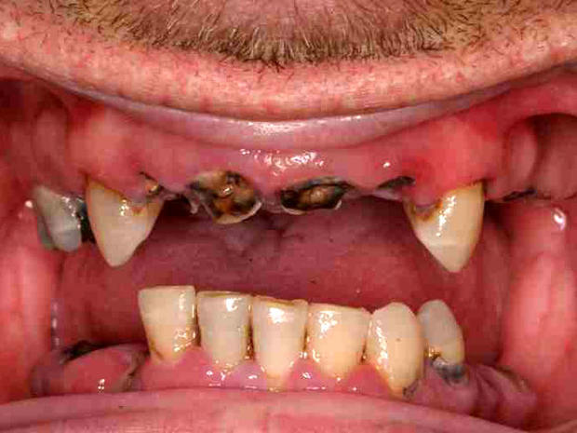
Objective: Introduce SUD Case Managers to oral health
elements in their SUD clients

Slide 4
Results From 1st Step House

Slide 5
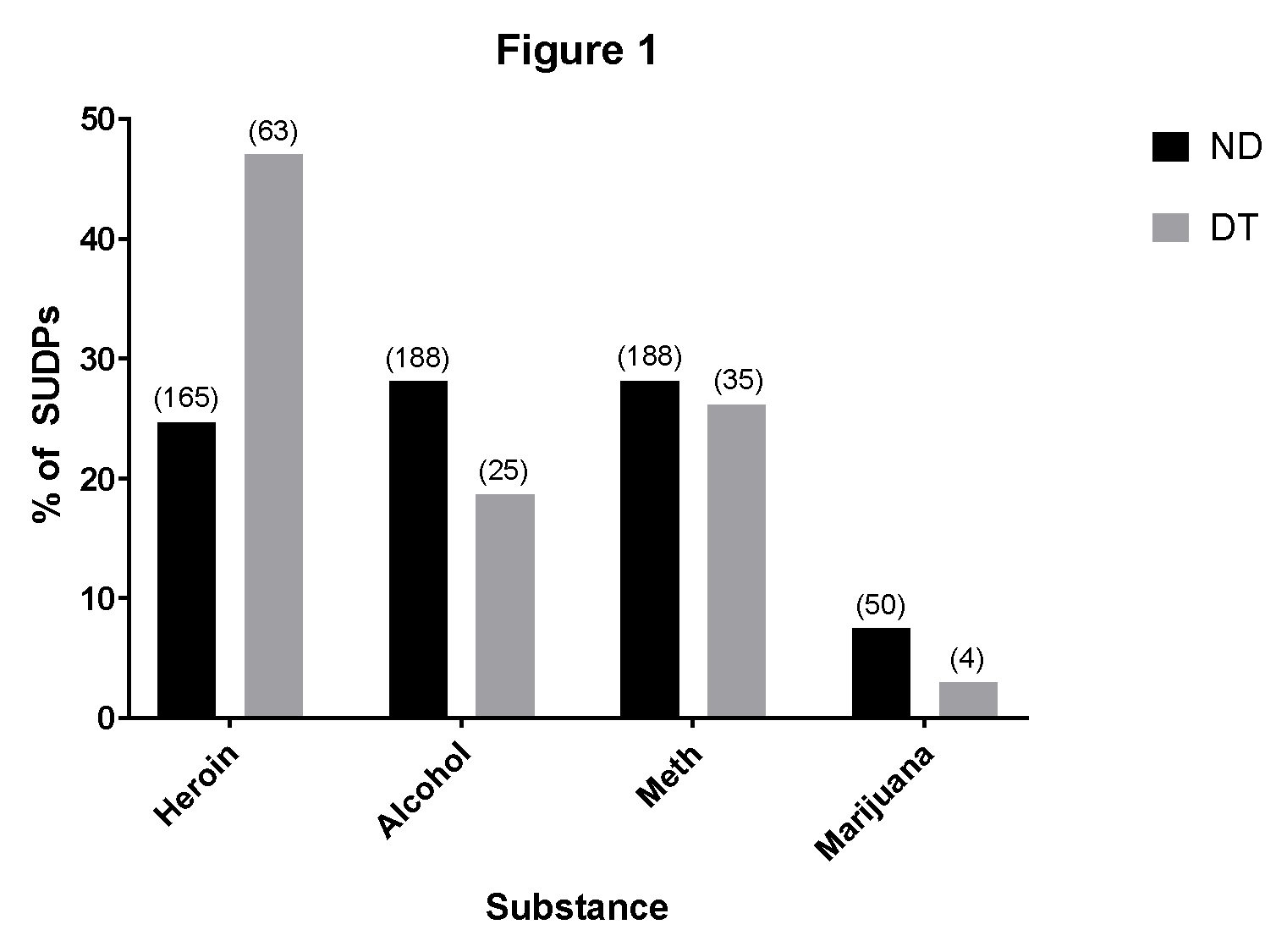
Patient Drug-of-Preference Demographics—
~ 50% of FLOSS patients (DT) used heroin as their
preferred drug

Slide 6
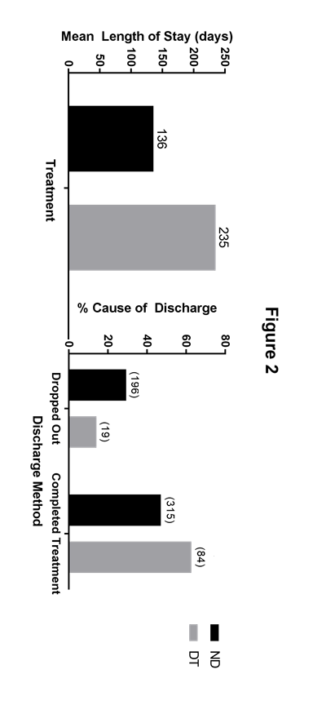
Duration of Treatment
DT clients were in treatment for almost 2X longer; much
less likely to drop out; and more likely to complete
Treatment.

Slide 7
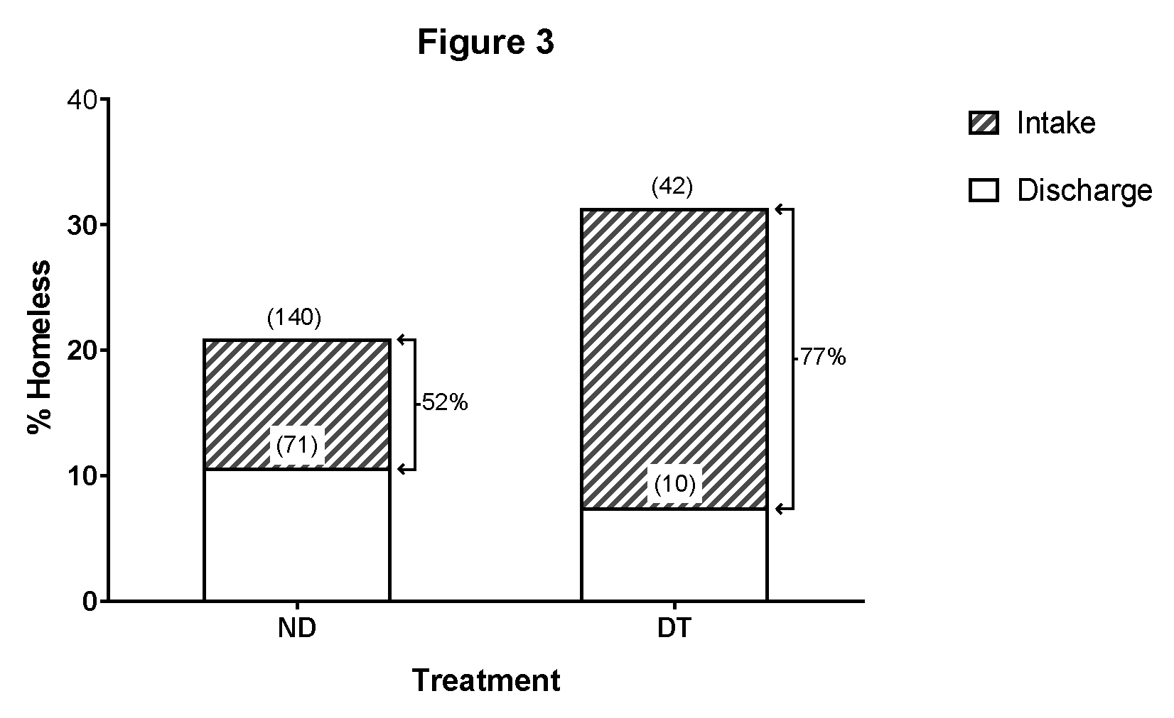
Effect on Homelessness
FLOSS patients much less likely to be homeless at
discharge

Slide 8
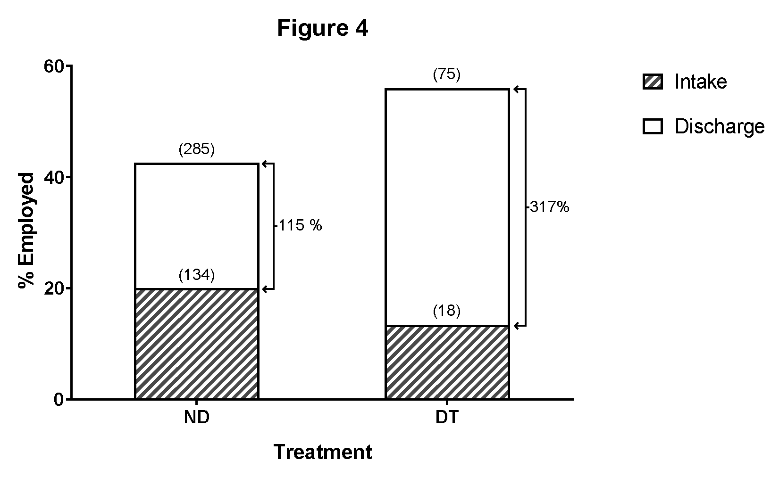
FLOSS clients much more likely to be employed at
time of discharge

Slide 9
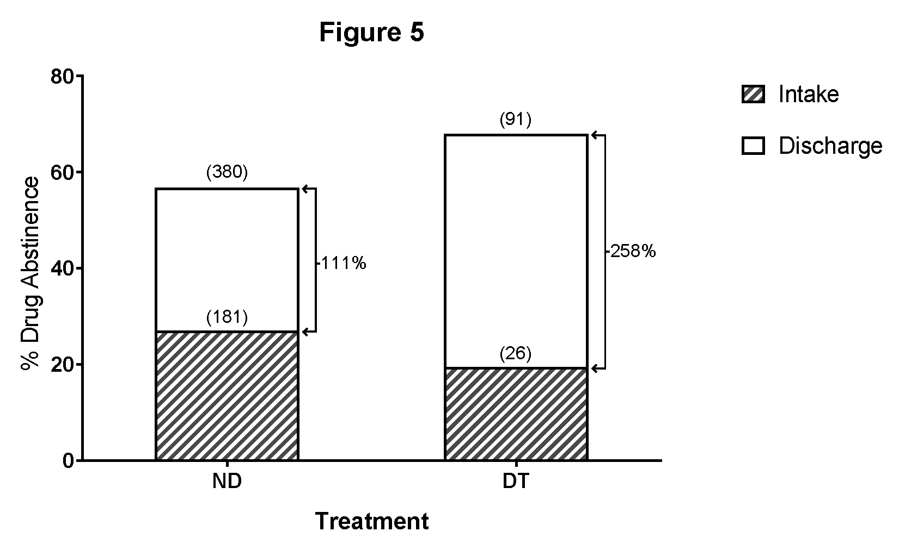
FLOSS patients much more likely to be abstinent from
drug use at time of discharge.

Slide 10
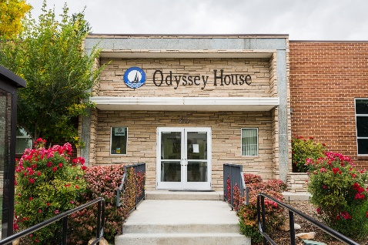
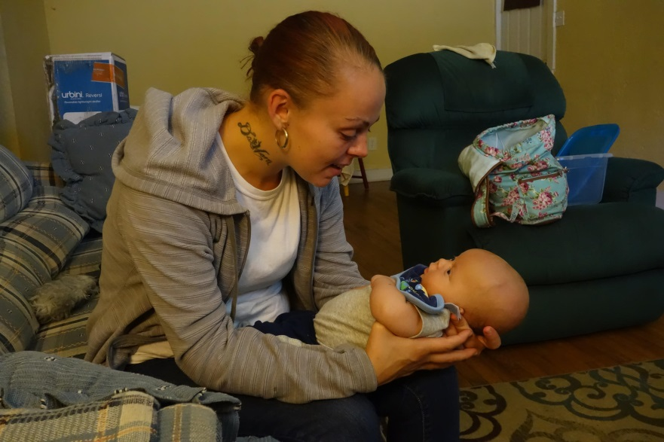
Odyssey House Findings
Patients:
-matched demographically and similar dental needs
-similar male and female
FLOSS= 165
Non FLOSS control= 158
Findings:
Length of Stay (LoS)
FLOSS= 340 days
Control= 122
Treatment completion
FLOSS were 63% more likely to complete than
controls
Gender differences for LoS effect
males and females similar LoS effects

Slide 11
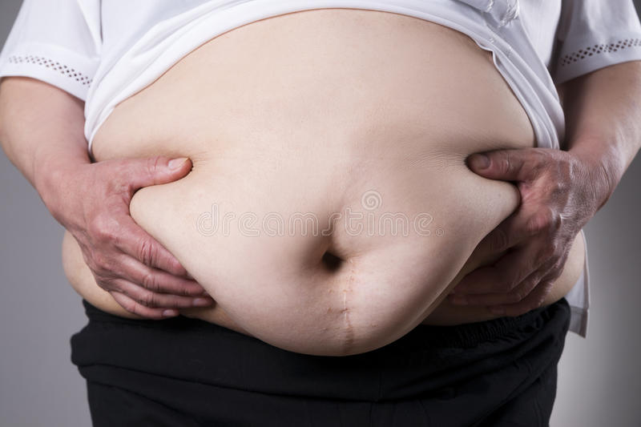
Implications:
Improved outcomes for SUD treatment
- Similar for all drugs (heroin, METH, alcohol, Marijuana)
Mechanism: likely by improving QoL or OHQoL
- Also impacts outcomes of other chronic, serious
long-term disorders that tends to have increased
oral health problems
-e.g.,
Prediabetes
CV disease
Mental health disorders
Cancer
Obesity
others

Slide 12
How to change findings into policy?—i.e. identify
resources to provide dental care to patients
receiving SUD treatment.
Approached Utah Medicaid Office, based on
FLOSS outcomes recommend expanding
Medicaid Dental coverage to include Medicaid
SUD patients
SUD dental Medicaid program approved
By Utah legislature—included ~8,000 SUD
(through TAM-Targeted, Adult, Medicaid) program).

Slide 13
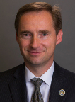
H.B. 435: sponsored by Rep.
Steve Eliason
Medicaid Dental Benefits
“…If a waiver is approved…the department shall
provide dental services to an individual who…
is receiving treatment for substance use disorder…
through the University of Utah School of Dentistry…”

Slide 14
2017 restored comprehensive dental, integrative dental care to Medicaid “blind and disabled”
2019 extended dental services to Medicaid TAM (Targeted Adult Medicaid) patients
2020 extended dental services to Medicaid Elderly (>65 years of age)
2021 Sole-source State-wide contract with UUSOD to provide dental care for all qualifying
adult groups (including TAM)
-UUSOD-affiliated clinics
*including former State dental facilities (i.e., Rose Park and Ogden clinics)
-Unique state-wide (including all rural communities) partnerships with 300 dentists

Slide 15
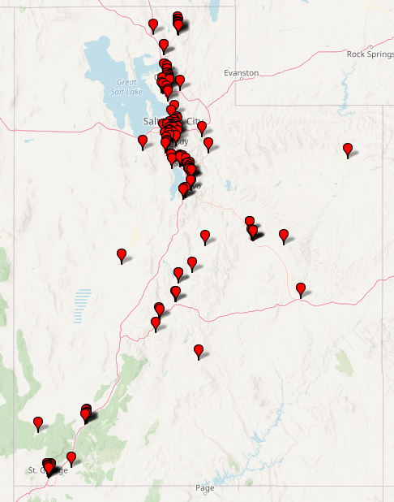
STATEWIDE COMMUNITY PARTNERS
We have the potential to care for more than 70,000 adults throughout Utah.
We partner with a network of 300+ dentists statewide for additional Medicaid (including TAM patients) coverage.

Slide 16
Questions??
Comments?
“Your Call Is Monitored for Quality Assurance. Anyone Who
Stays on Hold for 15 Minutes is a LOSER—So we’re
HANGING UP. “

